Slide 1
SIGN LANGUAGE RECOGNITION AND TRANSLATION
Team members :
20N31A6630 - Kshipra Singh
20N31A6639 - M.Samuel Cyril Raj
20N31A6659 – V. Hari Durga Prasad
Team Guide :
Dr. Jaishri W

Slide 2
AGENDA
ABSTARCT
DRAWBACK OF EXISTING SYSTEM
PROPOSED SYSTEM
ARCHITECTURE DIAGRAM
DEVICE REQUIREMENTS
APPLICATION MODULES
STATUS OF APPLICATION

Slide 3
ABSTRACT
Deaf and Mute people use hand gesture sign language to communicate, hence normal people face problems in recognizing their language by signs made. Hence there is a need for systems that recognize the different signs and conveys the information to normal people.
This need can be fulfilled with the help a Machine learning android application which deals from sign gesture acquisition and continues till text/speech generation. This can be very helpful for the deaf and dumb people in communicating with others as knowing sign language is not something that is common to all, making their day-to-day life much easier
The Sign Language app is an Android application which can translate Major sign languages of the world. This application breaks the barrier in between normal person and special enabled people.

Slide 4
DRAWBACKS OF EXISTING SYSTEM
In the existing system only the numerical sign or alphabets sign are recognised and translated .
The existing application is only restricted to few sign language symbols.
There is no existing application gives common inpretation between common language and sign language.
Static ASL and BSL can only be translated by the existing Application .

Slide 5
PROPOSED SYSTEMS
The proposed application can recognize and translate all the known sign language and provides much more user friendly interface.
This app we are building also provide a free sign language tutorial class for the user , this educate the user to learn sign language when there is no availability of the phone.
Using this application user can translate all the know sign languages in the real time environment.

Slide 6
PURPOSE OF THE APPLICATION
To break the barrier in between normal person and special enabled people .
To ease the communication between normal people(especially police and doctors) and deaf-mute
To help them in making their day to day life much easier.
To provide an efficient and accurate way to covert sign language into text or voice.

Slide 7
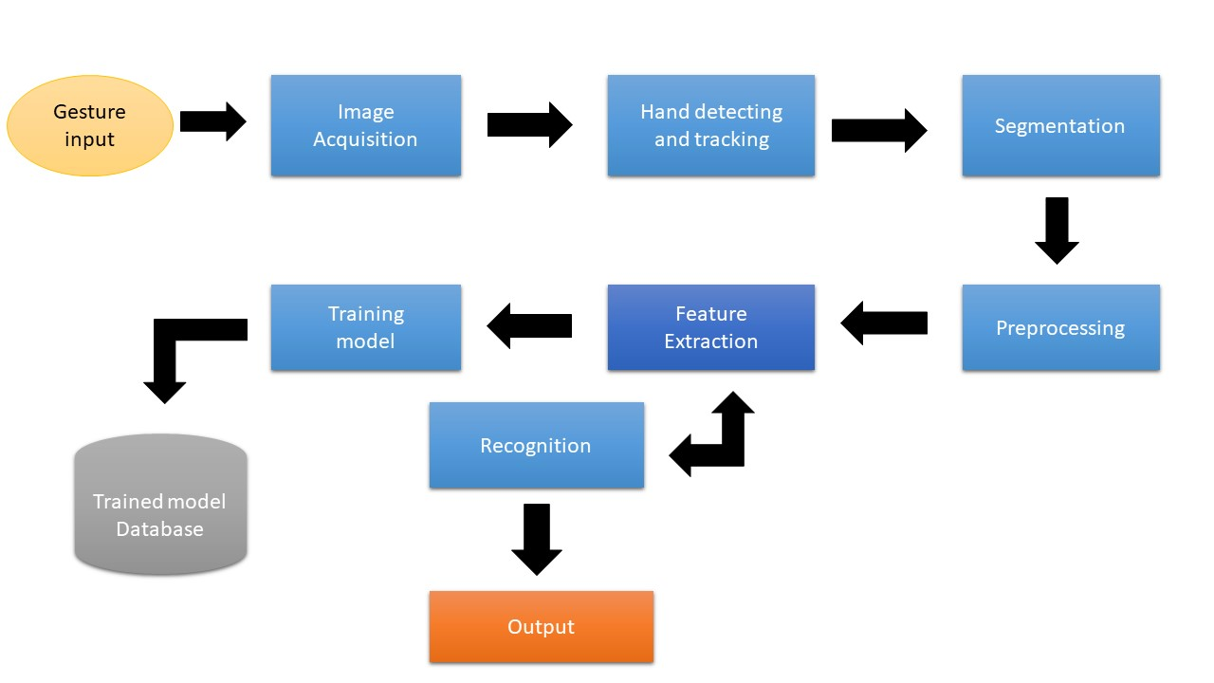
ARCHITECTURE DIAGRAM

Slide 8
DEVICE REQUIREMENTS
4GB RAM(recommended).
Supports any existing processor.
Android version 7 (recommended) or above

Slide 9
APPLICATION MODULES
Login module.
Vision module.
Tutorial module.
Gallery module
User profile module.
History module.

Slide 10
STATUS OF THE APPLICATION
SRS document is finished .
Gathered 50 %required inputs for training the model.

Slide 11
THANK YOU

